Slide 2
A Vision for London
To be the world’s healthiest global city
To be the best global city in which to receive healthcare

Slide 3
Global Healthy Cities : Rank Order
Hong Kong
Madrid
3/4 Sydney and Toronto (joint)
Tokyo
London
New York
Paris
Sao Paulo
Johannesburg
Note: London was previously ranked in seventh place. Paris has dropped below London in the rankings since 2014.

Slide 4
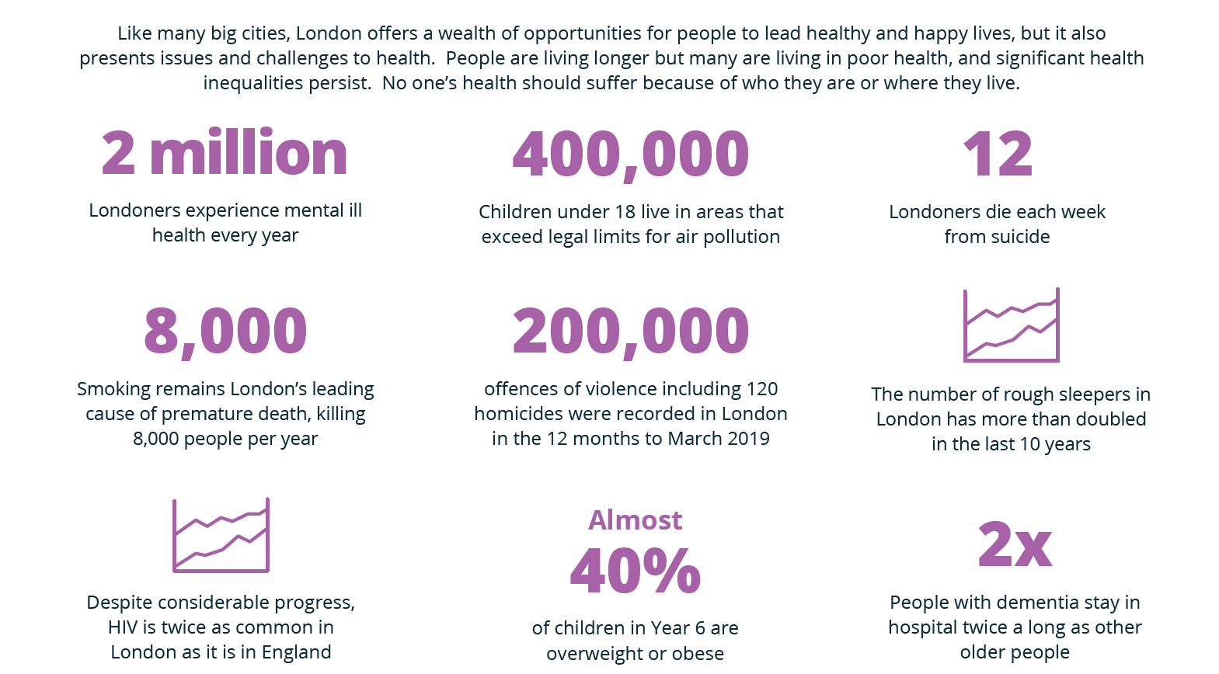
What Health Challenges Does London Face?

Slide 5
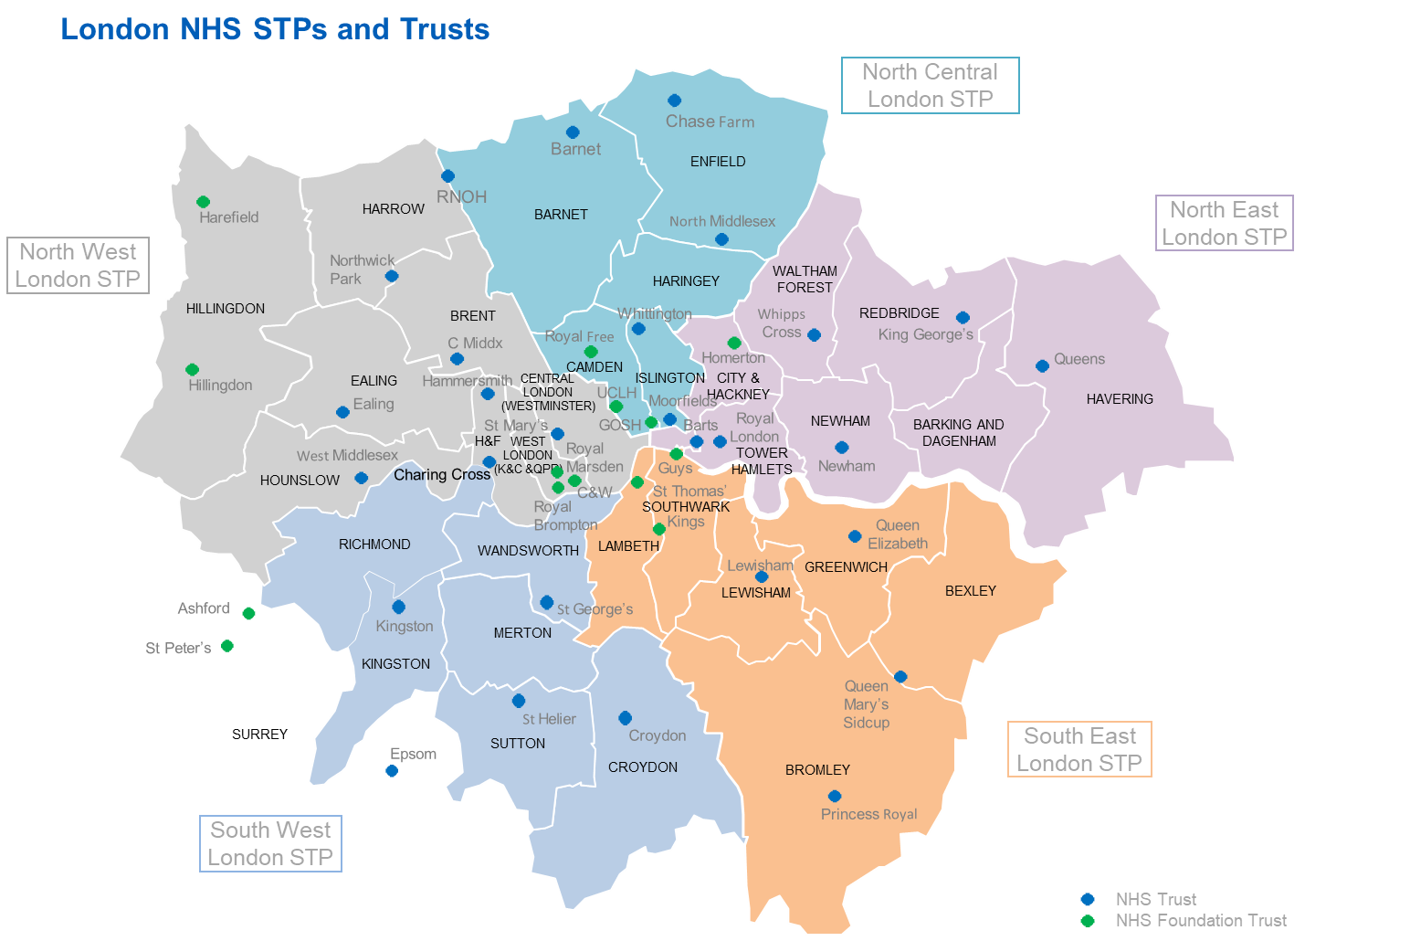
London has a highly complex health and care system
36 Trusts, including all hospital, mental health and community providers
1 ambulance service
18 acute hospital providers (9 NHS Foundation Trusts, 9 NHS Trusts)
5 Specialist trusts
2 Community trusts (both NHS Trusts)
10 mental health trusts (6 Foundation Trusts, 4 Trusts) providing mental health services
8,600 GPs
1,600 Practices and 32 Local Authorities

Slide 6
Approach to delivering the London Vision
10 health topics
Enablers;
- Digital
- Integration
- Estates

Slide 7
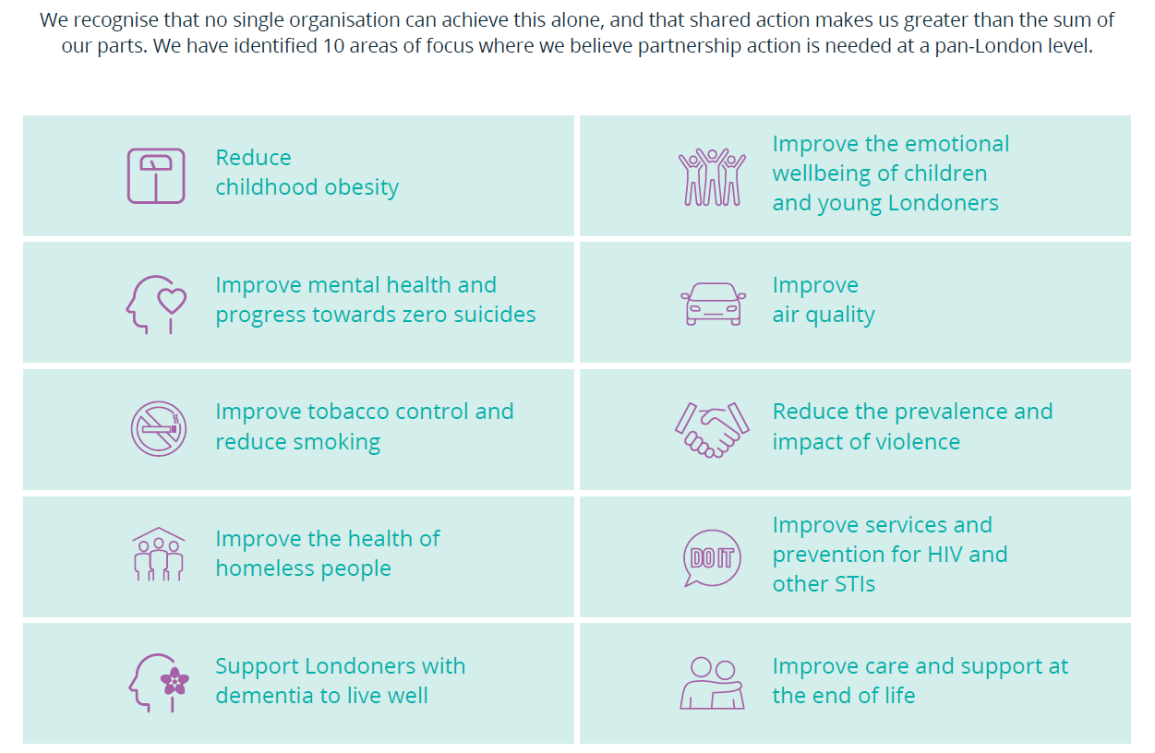
Health priorities

Slide 8
Next steps
Stakeholder engagement.
Nov- Jan
Analyze feedback
Dec – Jan
Confirm & implement
Partnership architecture, Deliverables,
Evaluation approach , System support offer.
Jan – March

Slide 9
Questions
How would you like to be involved - now and in the future?
What would be your preferred ways of working?
How can we build on your great work?
Which aspects of the Vision are you most interested in?
What would be your vision for how we can collectively go further faster?

Slide 10
Contact details.
Professor Paul Plant – Regional Director Public Health England
Emma.pawson@phe.gov.uk
The London Vision can be downloaded here;
https://www.healthylondon.org/vision/

